Slide 1

ADVANCED USER INTERFACES A.Y. 2021/2022
XR8: HOLOLIMB
Professor: Franca Garzotto
Tutors: Francesco Vona, Alberto Patti, Luca Pieri

Slide 2
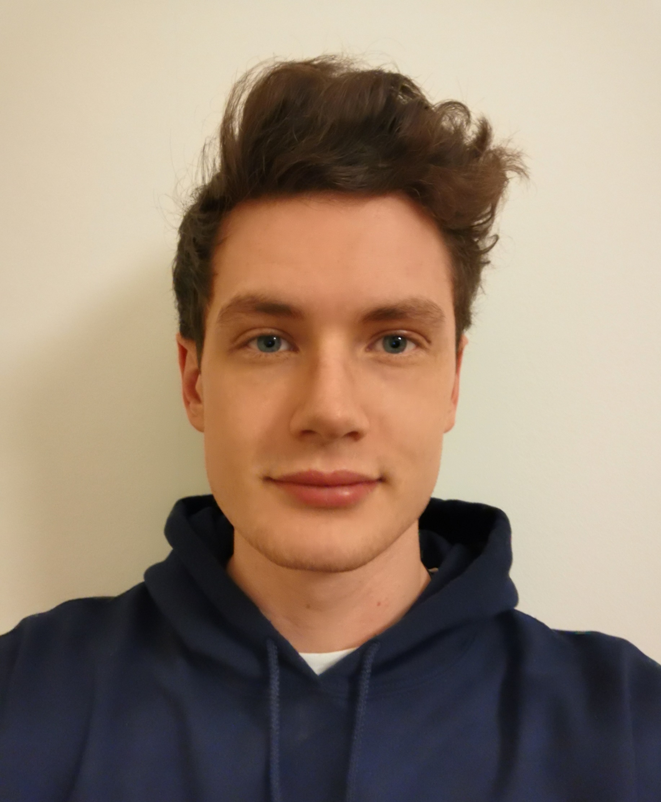
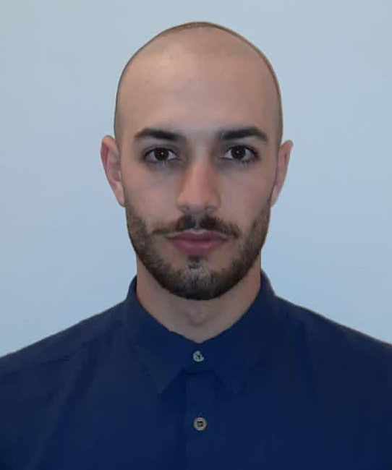
Who we are:
Carlo Leopoldo Reinotti
carloleopoldo.reinotti@mail.polimi.it
Human-Computer Interaction & Design (EIT Digital)
Enrico Sarneri
enrico.sarneri@mail.polimi.it
Computer Science & Engineering

Slide 3
The problem
Patients with an upper-limb amputation might suffer of Phantom Limb Sensations (PLS)
NEEDS of the main stakeholders:
Patients: mitigate or eliminate the pain or miscomfort caused by PLS with a non-invasive procedure
Researchers: gather useful data and feedback in order to develop new treatments

Slide 4
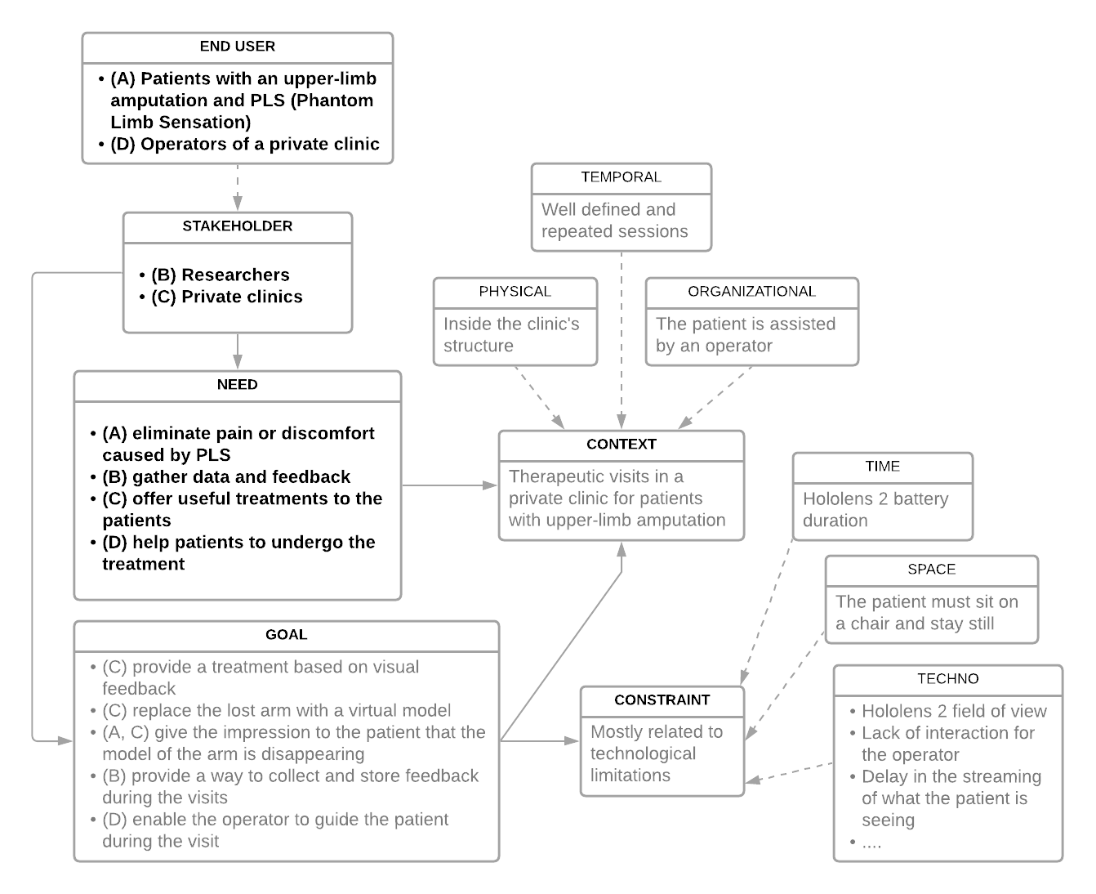
UNG model
Note: Stakeholders, Needs and Goals are mapped with the use of letters

Slide 5
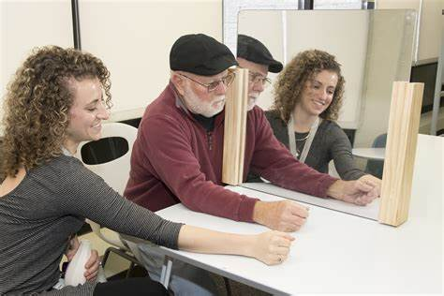
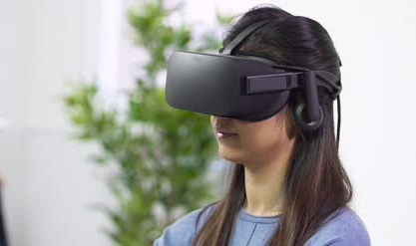
State of the art
Therapies are currently conducted in two ways:
With the use of a mirror placed trasversally in front of the user
The illusion of the lost arm is created by watching the reflection of the other one
By exploiting Virtual Reality environments with the use of Oculus Rift
https://academic.oup.com/painmedicine/article/20/10/2051/5511535

Slide 6



The solution
eXtended Reality application that:
creates a virtual model to substitute the missing upper limb
makes the model gradually disappear
The application was designed in three sections:
Configuration
Free mode
Therapy mode

Slide 7
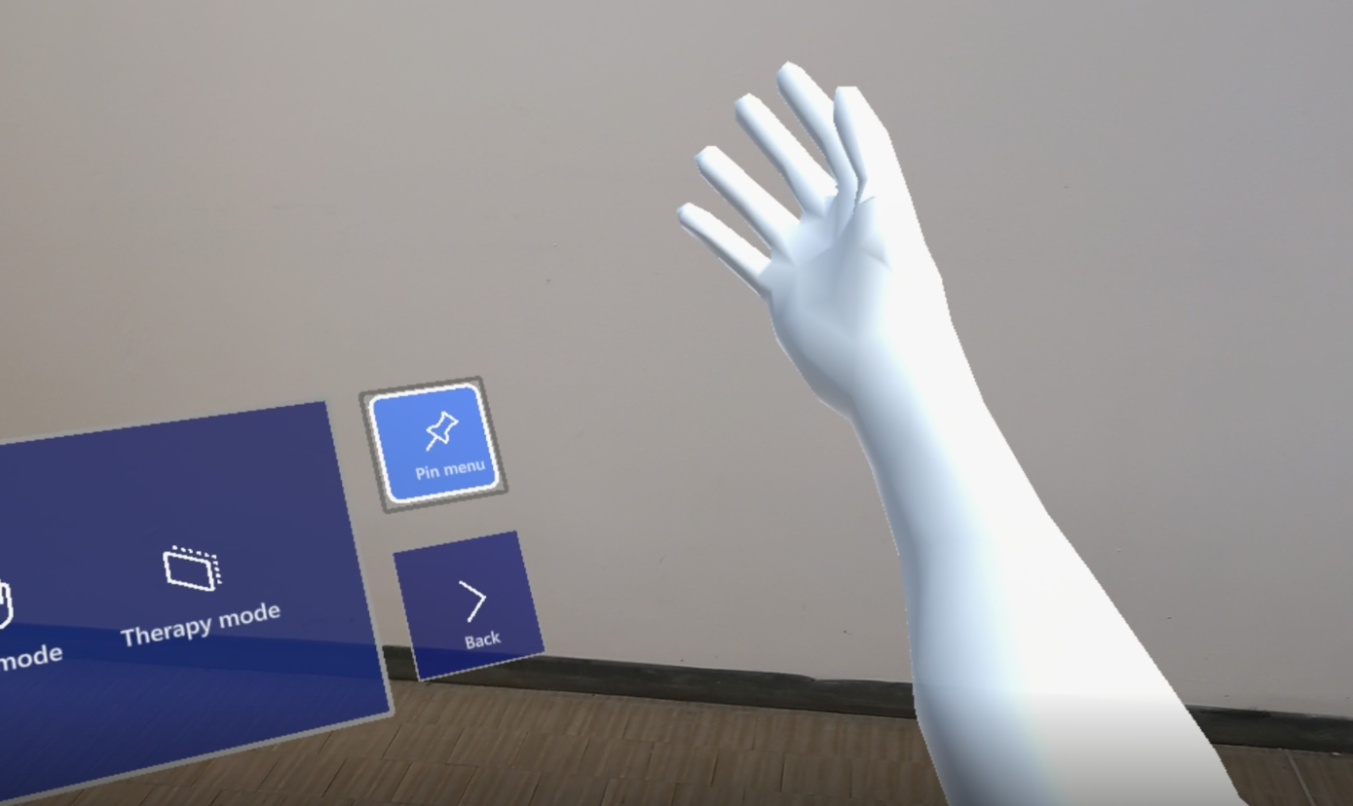

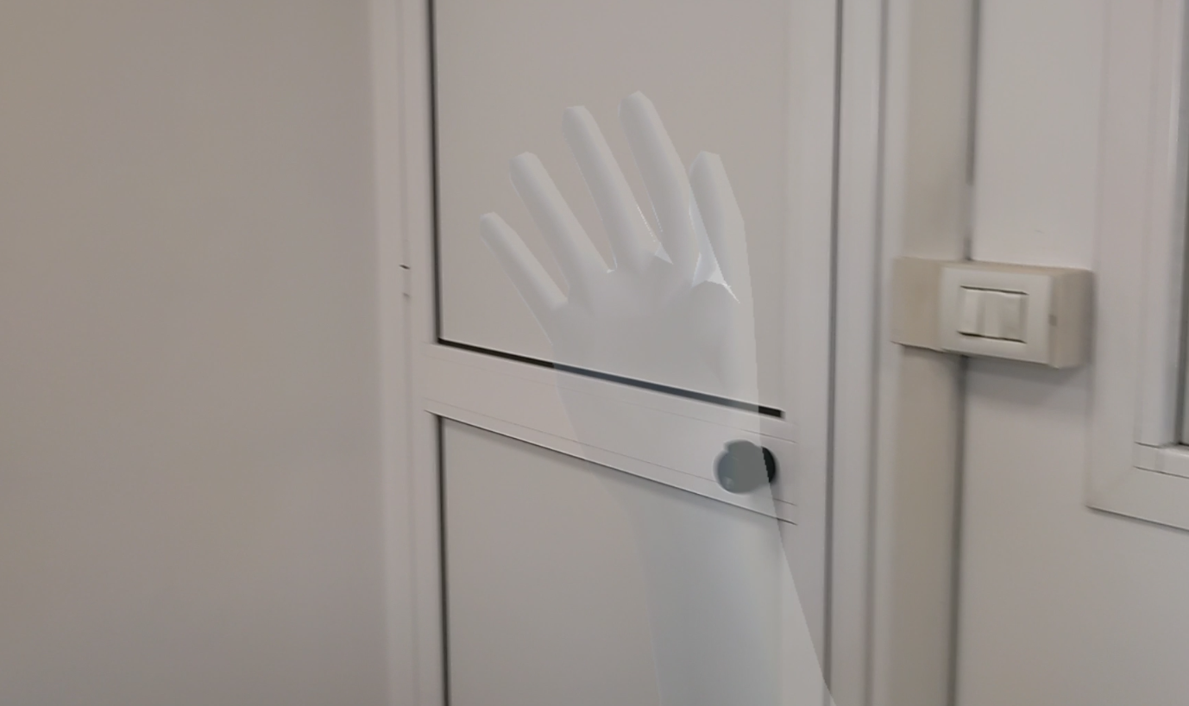
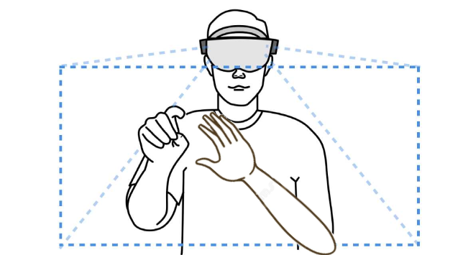
The solution
Configuration and Free Mode: the patient can manually modify
size
positions of the joints
transparency of the arm model

Slide 8
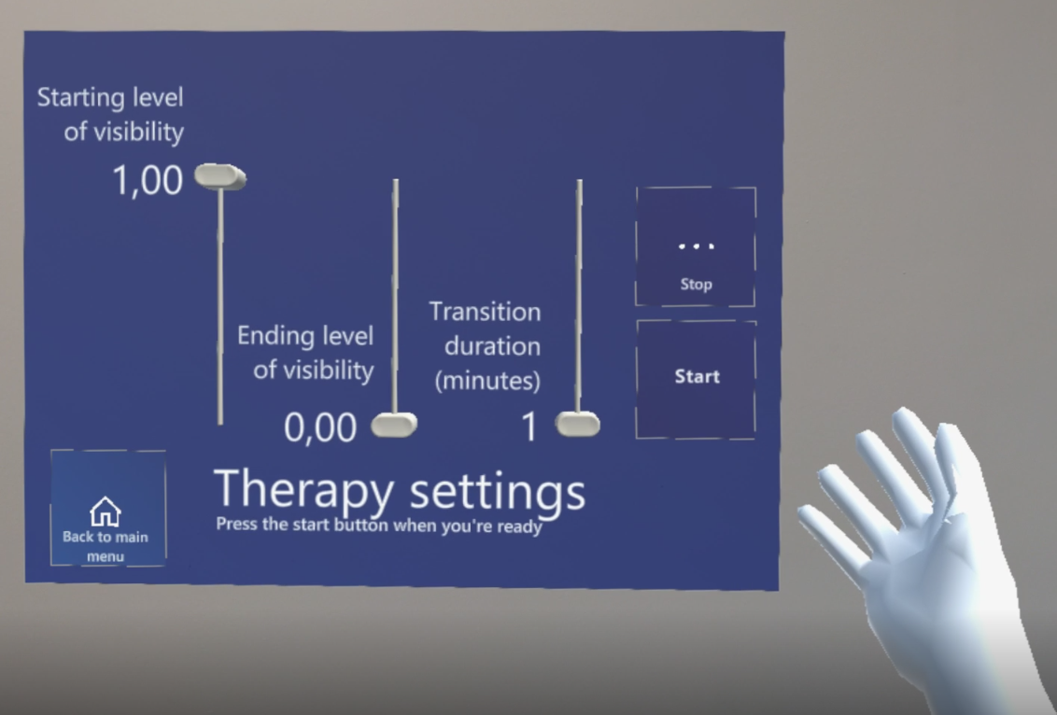
The solution
Therapy mode: visibility of the arm gradually and automatically modified
Three inputs
Values indicated by the operator
2 questionnaires are
available (see “Extra”)

Slide 9
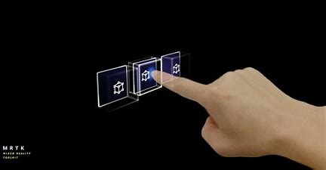
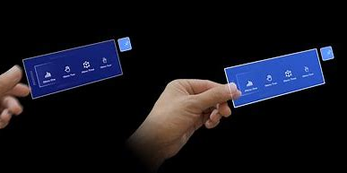
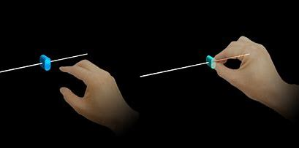
Interaction paradigms
We used few and simple interactions paradigms provided by Hololens 2:
All the buttons used are interactable by simply touching them
Objects can be grabbed and moved by pinching them with two fingers
Parameters are selected by means of pinchable sliders
All interactions are implemented for a single-handed use

Slide 10
Scenario 1
Peter has lost his left hand and is about to start his first therapeutic visit to heal from PLS. The clinic’s operator gives him a seat and helps him to wear the Hololens 2. Since it’s Peter’s first visit, the operator guides him through the Hololens 2 tutorial. Then Peter is asked to open the Hololimb application and guided by the operator through the menus in order to modify the arm’s properties such as the position, the size and the rotations of the joints. Peter is asked to enter the Therapy mode and select the three parameters (Starting level of visibility, Ending level of visibility, Transition duration) and press the start button. Once the ending message appears, Peter can fill both the questionnaire following the operator’s explanations and end the visit.

Slide 11
Scenario 2
Anna works in a clinic that provides treatments for PLS. Today she has an appointment with a patient who has lost his right arm and has already carried out most of his visits. Anna helps the patient to wear the Hololens 2 and opens the Windows Device Portal(WDP) to see the stream. Since the patient is now familiar with the application, Anna needs only to tell him the parameters of this visit. At the end of the therapy he patient fills out the questionnaire but doesn’t remember the specific meaning of a value. Anna clarifies the doubt and the patient can procede to the end of the visit. Once the patient has left, Anna uses the WDP to retrieve the .json files of the patient and renames them according to the clinic’s policy.

Slide 12
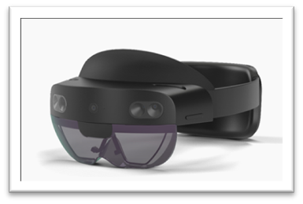





Technology
Unity and Visual Studio
Windows Device Portal

Slide 13
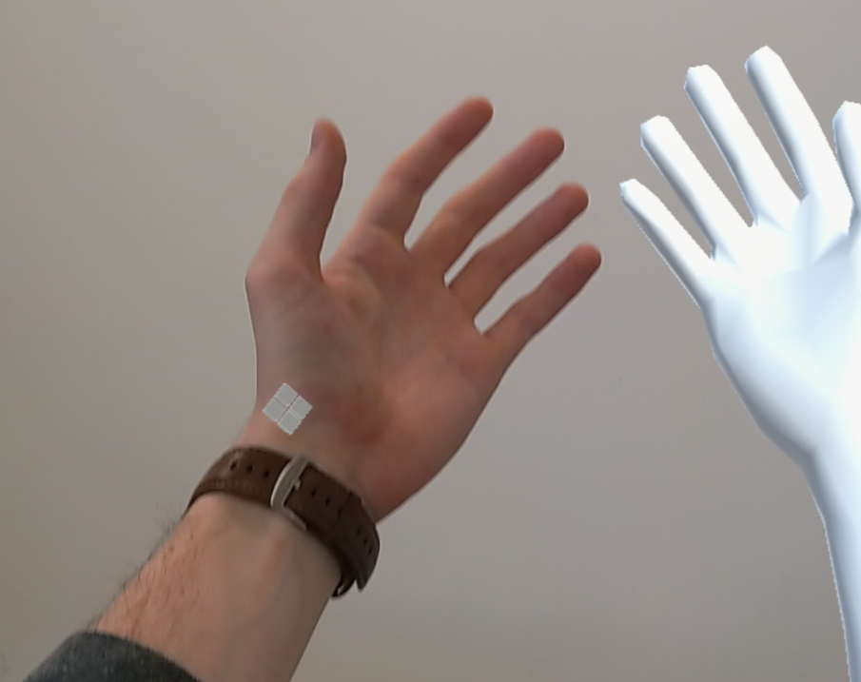
V
Value proposition
Through XR the feeling of immersion is deeply enhanced
Patients can interact with the arm, watch it disappear and compare it with the physical environment
not possible with VR and mirrors
Stem-tracking could provide motion feedback as well, reinforcing the feeling of immersion
In the scope of XR, there are no relevant competitors

Slide 14
Future work
Stem-tracking could be implemented in order to provide motion feedback
Further personalization of the arm could be implemented such as skin color, mesh pattern, etc.
Currently, the only joints that enable rotations are the elbow and the wrist, but this feature could be added to each finger
The use of the application could be extended to lower limbs

Slide 15
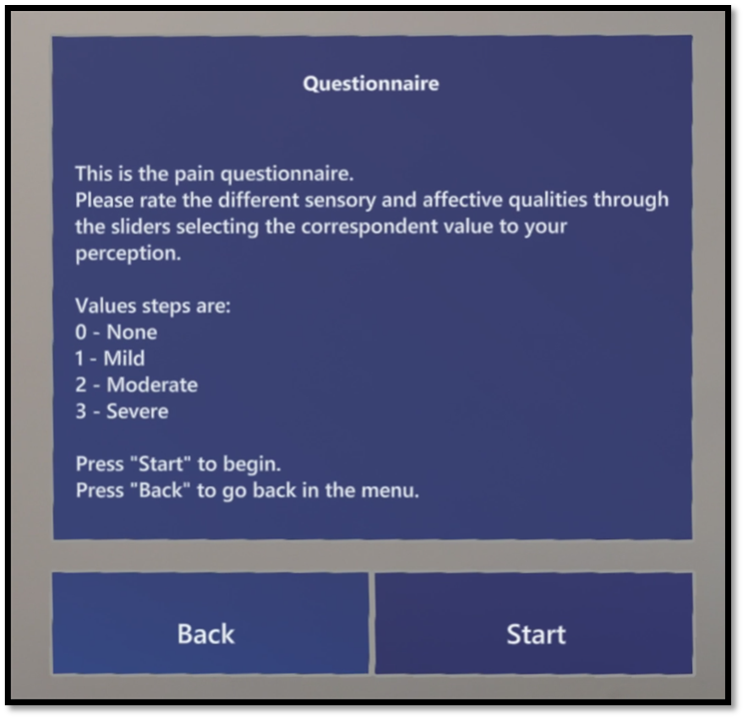
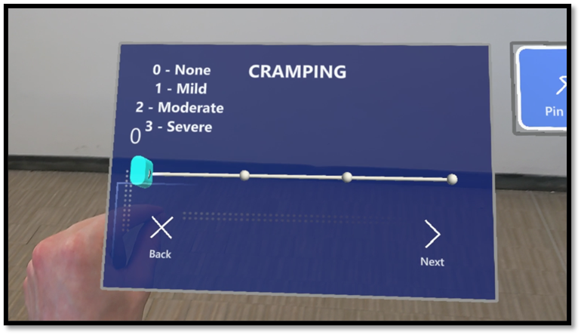
Extra - questionnaires
McGill’s introduction
Two questionnaire can be filled in:
Answers saved in .json files
Files named after type of questionnaire and timestamp…
… and retrievable through Windows Device Portal
Questionnaires:
Short-form of McGill pain questionnaire (https://www.physio-pedia.com/Short-form_McGill_Pain_Questionnaire )
A Brief Pain Inventory (Italian version)
A question

